Slide 1
Machine Learning Practical-1 Non-linear regression (NLR)
Lecturer:
Dr Hamid Khayyam (Australia)
Email: hamid.khayyam@rmit.edu.au

Slide 2
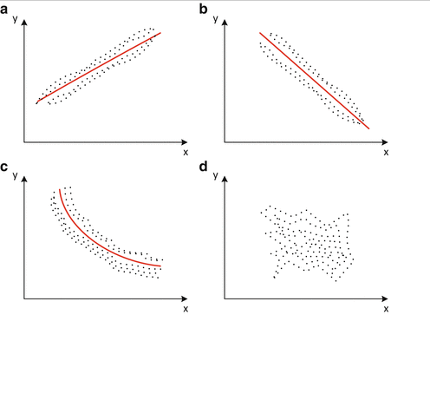
Regression analysis
Regression models describe the correlation between input and output variables.
Different types of correlation between Y and X. (a) Positive linear correlation (b) negative linear correlation (c) nonlinear correlation (d) no correlation

Slide 3
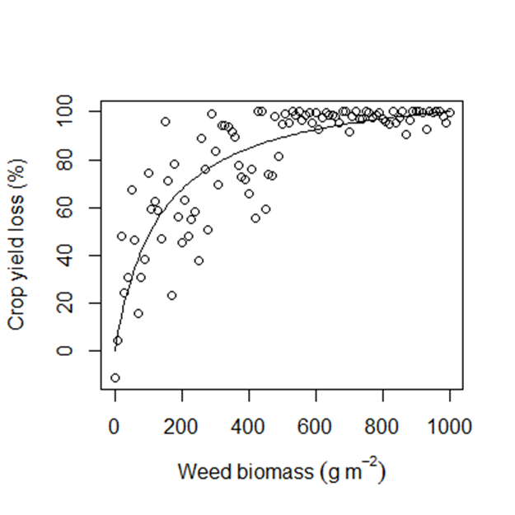
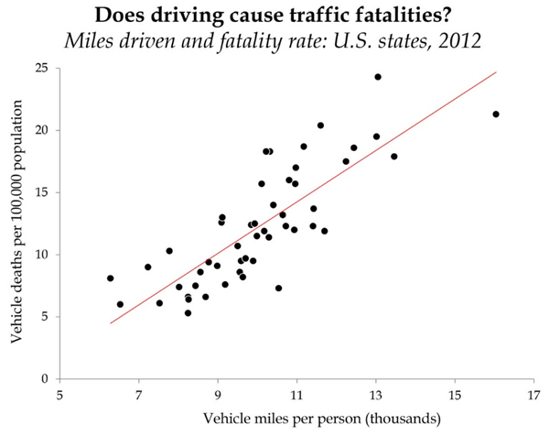
Example of linear and non-linear regression model
Linear Regression Model
Nonlinear Regression model

Slide 4

Linear regression model:
Linear regression is used to model a linear relationship between a continuous dependent variables Y(output) and independent variables X(input).
fitlm: Creates linear regression model.
Syntax:
mdl = fitlm(x,y);
mdl = fitlm(x,y,modelspec);
Description:
x: Predictor variables(Input)
y: Response variable(output)
modelspec: Model specification
Predict: Predict response of linear regression model
Syntax:
ypred = predict(mdl,Xnew);

Slide 5
Example of Linear regression function: fitlm
clear;clc;
rng(1);
load hald % built-in data set in Matlab
mdl = fitlm(ingredients,heat,'linear') ;
heatpred = predict(mdl,ingredients);
table( heat( : ),heatpred( : ), 'VariableNames',...
{' Heat',' Predicted_heat'}) %Show the results of output data and predicted output.

Slide 6
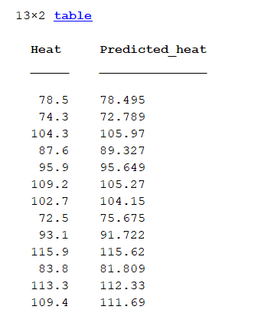
Example of Linear regression function: fitlm (cont.)

Slide 7
Example of Linear regression function (2): fitlm (cont.)
clear;clc;
rng(1);
Filename='regression1.xlsx';
Sheetread='Sheet1';
Input1='A1:A100';
output1='B1:B100';
Input=xlsread(Filename,Sheetread,Input1); %Read Microsoft Excel
Target=xlsread(Filename,Sheetread,output1 );
x=Input;
t=Target;
t= fillmissing(t,'spline'); %fill in the missing output data

Slide 8
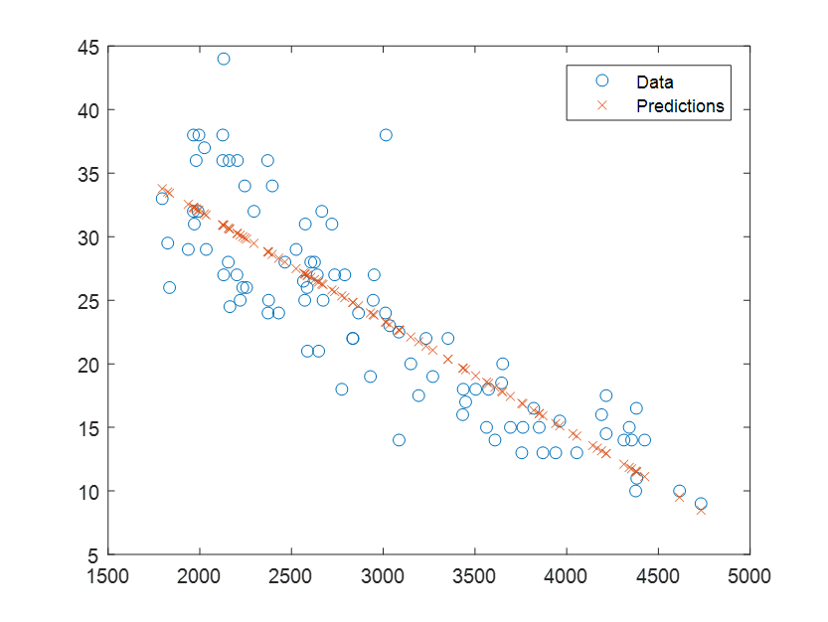
mdl = fitlm(X,y,'linear');
ypred = predict(mdl,X);
plot(X,y,'o',X,ypred,'x')
legend('Data','Predictions')

Slide 9
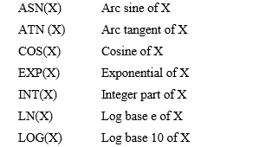
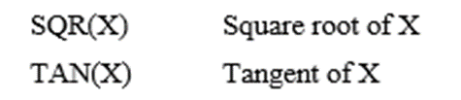
Nonlinear regression models/functions
Nonlinear regression model is a nonlinear correlation of a continuous dependent variables Y(output) and independent variables X(input).
Examples of Nonlinear functions

Slide 10
Examples of nonlinear models in Matlab
Y=b(1) + b(2)*x(:,1).^b(3) +b(4)*x(:,2).^b(5)
Y=x(:,1).*exp(x(:,2))
Y = (b(1)*x2 – x(:,3)/b(5))./(1+b2*x(:,1)+b(3)*x(:,2)+b(4)*x(:,3));
Y=b(1)+b(2) *x(:,1)+b(3) *x(:,2)+b(4) *x(:,3)
Y=b(1)+b(2) *x(:,1)+b(3) *x(:,2)+b(4) *x(:,3)+b(5) *(x(:,1).^2)+b(6) *x(:,3) +b(7) *((x(:,1).*x(:,2).*x(:,3)));

Slide 11
Matlab function for non-linear polynomial models: polyfit
polyfit: A Matlab solver for non-linear polynomial models.
Syntax:
p = polyfit(x,y,n)
Describe:
Returns the coefficients for a polynomial p(x) of degree n that is a best fit for the data in y. x is the input ,y is the output.
polyval
Syntax:
ypredicted = polyval(p,x)
Describe:
To predict y based on x.

Slide 12
Example of ‘polyfit’ Matlab function 1:
clear ;clc;
x=[0.1 0.2 0.4 0.6 0.9 1.3 1.5 1.7 1.8]
y=[0.75 1.25 1.45 1.25 0.85 0.55 0.35 0.28 0.18]
p1=polyfit(x,y,7);% returns the coefficients for a polynomial p(x) of degree 7
y2=polyval(p1,x);
plot(x,y,'o',x,y2,'-');
table( y( : ),y2( : ), 'VariableNames',...
{' Original_y',' Predicted_y'}) %Show the results of data of the output and predicted output.

Slide 13
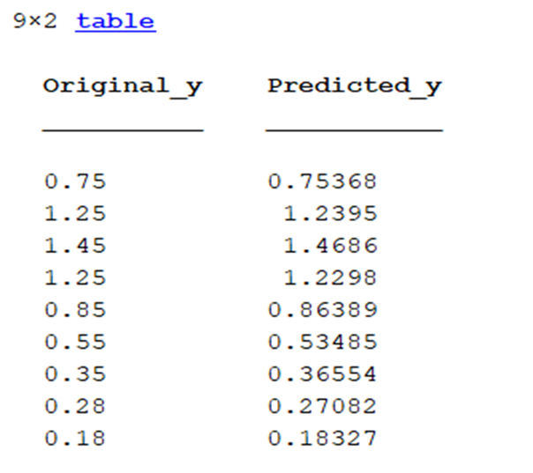
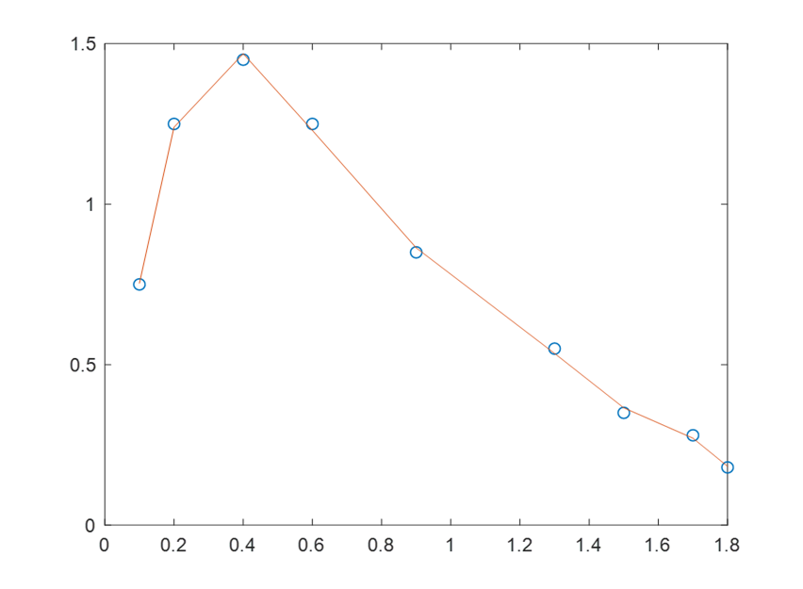
Example of ‘polyfit’ Matlab function (cont.) 2:

Slide 14
Example of ‘polyfit’ Matlab function 2 (cont.):
clear;clc;
x = linspace(0,1,5); % input
t = 1./(1+x);% output
p = polyfit(x,t,4); %gives the coefficient
xnew = linspace(0,2); % new x (generate linearly)
tnew = 1./(1+xnew); % new y
ynew = polyval(p,xnew); % polynomial evaluation
figure
plot(x,t,'o')
hold on
plot(xnew,tnew)
plot(xnew,ynew,'r--')
legend('t','tnew','ynew')

Slide 15
Example of ‘polyfit’ Matlab function 2 (cont.):

Slide 16
Example of ‘polyfit’ Matlab function 3:
0 0.562
0 0.58
0 0.549
25 0.572
25 0.6
25 0.572
57 0.744
57 0.749
57 0.742
90 0.776
90 0.789
90 0.824
115 0.959
115 0.993
115 0.949
136 1.248
136 1.282
136 1.304
165 1.492
165 1.468
165 1.49
186 1.854
186 1.804
Data =

Slide 17
Example of ‘polyfit’ Matlab function 3 (cont.):
clear;clc;
figure(1);
plot(data(:,1),data(:,2),'ks');grid on;% plotting with black squares
x=data(:,1);
y=data(:,2);
m1=polyfit(x,y,1); %build a first order polynomial model ,m1 are the coefficients
p1=polyval(m1,x);
m2=polyfit(x,y,2);%build a second order polynomial model ,m2 are the coefficients
p2=polyval(m2,x);
m3=polyfit(x,y,3);%build a second order polynomial model ,m3 are the coefficients

Slide 18
Example of ‘polyfit’ Matlab function 3 (cont.):
p3=polyval(m3,x);
m4=polyfit(x,log(y),1);%build a logarithmic model of order 1 ,m4 are the coefficients
p4=polyval(m4,x);
figure(2);
subplot(2,2,1),plot(x,y,'ko'),hold on,plot(x,p1,'k--');grid on,title('first order');
subplot(2,2,2),plot(x,y,'ko'),hold on,plot(x,p2,'k--');grid on,title('second order');
subplot(2,2,3),plot(x,y,'ko'),hold on,plot(x,p3,'k--');grid on,title('third order');
subplot(2,2,4),plot(x,log(y),'ko'),hold on,plot(x,p4,'k--');grid on,title('logarithmic fit');

Slide 19
Original data
Original data and polynomial fit

Slide 20
Nonlinear functions solver: lsqcurvefit
lsqcurvefit: A Matlab solver for non-linear models.
Syntax:
m = lsqcurvefit(modelfun, beta0,x,t)
Description:
Solve non-linear curve-fitting (data-fitting) problems in least-squares sense.
fun : Function you want to fit.
beta0 — Coefficients
x: Input data for model
t : Out put for model
Prediction
Syntax:
Ypredicted=modelfun(m,x);

Slide 21
Example of Non-linear regression function (1) : lsqcurvefit
clear;
clc;
rng(1);
x = linspace(0,3);
t = exp(-1.3*x) + 0.05*randn(size(x));
fun = @(b,x)b(1)*exp(b(2)*x); % Defining the Model function
b0 = [1/2,-2]; %Coefficient initiation
mdl = lsqcurvefit(fun,b0,x,t); % obtaining the coefficients.
ypredicted=fun(mdl,x);
plot(x,t,'ko',x,ypredicted,'b-')
legend('Data','Fitted exponential')
title('Data and Fitted Curve')

Slide 22
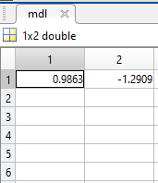
Example of Non-linear regression function (1) : lsqcurvefit (cont.)

Slide 23
Example of Non-linear regression function (2) : lsqcurvefit
clear ;
clc;
rng(1);
x = [-2,-1.64,-1.33,-0.7,0,0.45,1.2,1.64,2.32,2.9];
t = [0.699369,0.700462,0.695354,1.03905,1.97389,2.41143,1.91091,0.919576,-0.730975,-1.42001];
fun = @(b,x)b(1)*cos(b(2)*x)+b(2)*sin(b(1)*x);
b = [1,0.2];
mdl = lsqcurvefit(fun,b,x,t);% mdl will be the coefficients
ypredicted=fun(mdl,x);%This equals to yexpected =mdl(:,1)*cos(mdl(:,2)*x)+mdl(:,2)*sin(mdl(:,1)*x)
plot(x,t,'ko',x,ypredicted,'b-')

Slide 24
Example of Non-linear regression function (2) : lsqcurvefit (cont.)

Slide 25
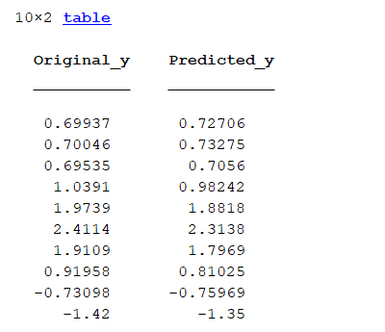
Example of Non-linear regression function (2) : lsqcurvefit (cont.)
legend('Data','Fitted exponential')
title('Data and Fitted Curve')
table( t(: ),ypredicted(:), 'VariableNames',...
{' Original_y',' Predicted_y'})

Slide 26
Non-linear regression Matlab function (fitnlm):
fitnlm: A non-linear regression Matlab solver for non-linear models.
Syntax:
mdl = fitnlm(x,y,modelfun,beta0)
x: Predictor variables(Input)
y: Response variable(output)
Modelfun: Functional form of the model (model you want to fit )
Beta0: Coefficients
Predict: Predict response of the regression model
Syntax:
ypred = predict(mdl,Xnew);

Slide 27
Example of Nonlinear regression function 1: fitnlm
rng(1);
Filename='regression2.xlsx';
Sheetread='Sheet1';
Input1='A1:B406';
output1='C1:C406';
Input=xlsread(Filename,Sheetread,Input1); %Read Microsoft Excel
Target=xlsread(Filename,Sheetread,output1 );
x=Input;
t=Target;
modelfun = @(b,x)(b(1) + b(2)*x(:,1).^b(3) +...
b(4)*x(:,2).^b(5)); % nonlinear model

Slide 28
Example of Nonlinear regression function 1: fitnlm (cont.)
beta0 = [-50 500 -1 500 -1]; % coefficients initiation
mdl = fitnlm(x,t,modelfun,beta0);
y_expected = predict(mdl,x);
table( t (10:20 ),y_expected( 10:20 ), 'VariableNames',...
{' TrueLabel',' PredictedLabel'}) %Show the results of 1st to 10th data of the output and predicted output.
MSE_training= (mean((t - y_expected).^2));
RMSE_training = sqrt(mean((t - y_expected).^2));

Slide 29
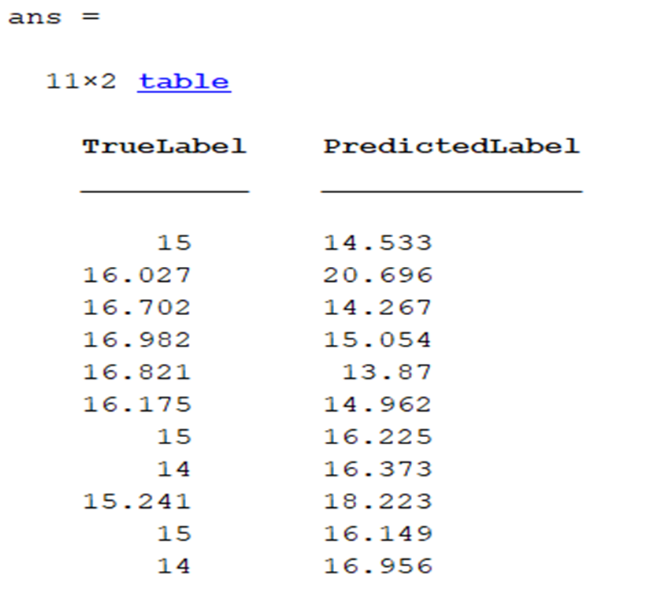
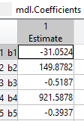
MSE_training =16.1174
MSE_testing =4.0147

Slide 30
Example of Nonlinear regression function 2: fitnlm
clear;clc;
rng(1);
Filename='regression3.xlsx';
Sheetread='Sheet1';
Input1='A1:C13';
output1='D1:D13';
Input=xlsread(Filename,Sheetread,Input1); %Read Microsoft Excel
Target=xlsread(Filename,Sheetread,output1 );
x=Input;
t=Target;
beta = [1 1 1 1 1]; % coefficient initiation
fun = @(b,x)((b(1)*x(:,2)-x(:,3)/b(5))./(1+b(2)*x(:,1)+b(3)*x(:,2)+b(4)*x(:,3)));
mdl = fitnlm(x,t,fun,beta)

Slide 31
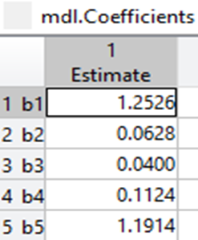
Example of Nonlinear regression function 2: fitnlm (cont.)
y_expected = predict(mdl,x);
table( t( 5:10 ),y_expected( 5:10 ), 'VariableNames',...
{' Actual_Y',' PredictedY'}) %Show the results of 5th to 10th data of the output and predicted output.
MSE_training= (mean((t - y_expected).^2));
RMSE_training = sqrt(mean((t - y_expected).^2));
MSE_training =0.0230
MSE_testing =0.1516

Slide 32
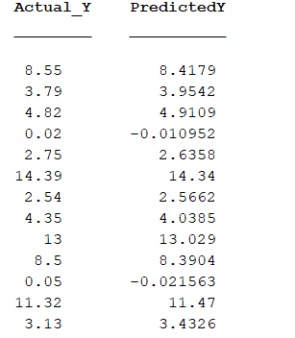
Example of Nonlinear regression function 2: fitnlm (cont.)

Slide 33
Example of Nonlinear regression function 3: fitnlm
Clear;clc;
rng(1);
Filename='regression4.xlsx';
Sheetread='Sheet1';
Input1='A1:C72';
output1='D1:D72';
Input=xlsread(Filename,Sheetread,Input1); %Read Microsoft Excel
Target=xlsread(Filename,Sheetread,output1 );
x=Input;
t=Target;
[xn,sxn] = mapminmax(x');% Standardize x
[tn,stn]= mapminmax(t');% Standardize t
Sheetread1='Sheet2';
Input2='A1:C3';

Slide 34
Example of Nonlinear regression function 3: fitnlm (cont.)
Target2 ='D1:D3';
Inputnew=xlsread(Filename,Sheetread1,Input2);
Targetnew=xlsread(Filename,Sheetread1,Target2 );
xnew=Inputnew;
tnew=Targetnew;
xnewn = mapminmax('apply',xnew',sxn); % The same Process setting of
%standardization for x should also be applied for xnew.
%xnewn is the
%standardized xnew
xn=xn';% standardized x
tn=tn';% standardized t
xnewn=xnewn';%standardized xnew
beta = [1 1 1 1 1 1]; % coefficient initiation

Slide 35
Example of Nonlinear regression function 3: fitnlm (cont.)
fun=@(b,xn)b(1)+b(2)*xn(:,1)+b(3)*xn(:,2)+b(4)*xn(:,3)+b(5)*(xn(:,1).^2)+b(6)*((xn(:,1).*xn(:,2).*xn(:,3)));% nonlinear model with standardized x
mdl = fitnlm(xn,tn,fun,beta);% find coeffcients(beta) of model(fun )using normalized x and t
yfitn = predict(mdl,xn);% make prediction based on normalized x
yfit = mapminmax('reverse', yfitn,stn); % To reverse the prediction to original state using the same process setting of t
table( t( 10:20 ),yfit( 10:20 ), 'VariableNames',...
{' TrueLabel',' PredictedLabel'}) %Show the results of 5th to 10th data of the output and predicted output.
MSE_training=sum((yfit-t).^2)/numel(t); % Calculate MSE for data
RMSE_training=sqrt(sum((yfit-t).^2)/numel(t)); % Calculate RMSE for data

Slide 36
Example of Nonlinear regression function 3: fitnlm (cont.)
ynewn=predict(mdl,xnewn);% make prediction based on normalized new data
ynew = mapminmax('reverse', ynewn,stn); % To reverse the normalized ynew and use the processing setting of t
table(tnew(:),ynew(:),'VariableNames',{'ObservedValue_Newdata',' PredictedValue_newdata'}) % show data in output and predicted output
% MSE_testing1=mse(tnew,ynew);
MSE_testing=sum((tnew-ynew).^2)/numel(tnew); % Calculate MSE for new data
RMSE_testing=sqrt(sum((tnew-ynew).^2)/numel(tnew)); % Calculate RMSE for new data
Errorpercentage=((ynew-tnew)./tnew)*100; % Calculate error percentage for tnew and ynew

Slide 37
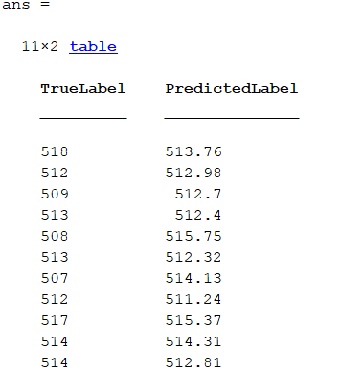
MSE_training =11.0469
MSE_testing =3.98557

Slide 38
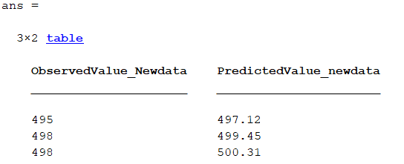
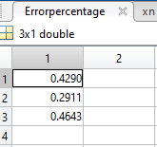
RMSE_training =3.3237
RMSE_testing =1.9964

Slide 39
Examples of non-linear model functions ( Using combination of Power , Exponential, polynomial functions ) :
fun=@(b,x)b(1)+b(2)*x(:,1)+b(3)*x(:,2)+b(4)*x(:,3)+b(5)*(x (:,1).^2)+b(6)*((x(:,1).*x(:,2).*x(:,3)));
fun=@(b,x)b(1)+b(2)*x(:,1)+b(3)*x(:,2)+b(4)*x(:,3)+b(5)*(x(:,1).^2);
fun=@(b,x)b(1)+b(2)*x(:,1)+b(3)*x(:,2)+b(4)*x(:,3)+b(5)*(x(:,1).^2)+b(6)*x(:,2).^2;
fun=@(b,x)b(1)+b(2)*x(:,1)+b(3)*x(:,2)+b(4)*x(:,3)+b(5)*(x(:,1).^2)+b(6)*exp(x(:,1));
fun=@(b,x)b(1)+b(2)*x(:,1)+b(3)*x(:,2)+b(4)*x(:,3)+b(5)*(x(:,1).^2)+b(6)*x(:,3) +b(7)*((x(:,1).*x(:,2).*x(:,3)));
fun=@(b,xn)b(1)+b(2)*xn(:,1)+b(3)*xn(:,2)+b(4)*xn(:,3)+b(5)*(xn(:,1).^2)+b(6)*((xn(:,1).*xn(:,2).*xn(:,3))+b(7).*exp(b(8)*xn(:,3)))

Slide 40
References for regression functions and methods:
https://au.mathworks.com
S. Araghinejad, Data-Driven Modeling: Using MATLAB® in Environmental Engineering

